Slide 1

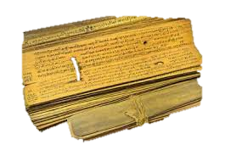






Discover Lasting Solution
Temporary Stop-Gap Material Solutions
Perfect Lasting Vedic Solutions
How to put full stop to the REAL Problems of Life?
Keynote Speaker:
DATE : 16th December, 2023
TIME : 09:30 AM, Sat
K. Loknath Reddy
👉B. Tech from SV University ,Tirupati
👉Working as Software Engineer in INFOSYS Technology, Chennai
👉Mentor for IIT Tirupati Students

Slide 3



